Slide 1
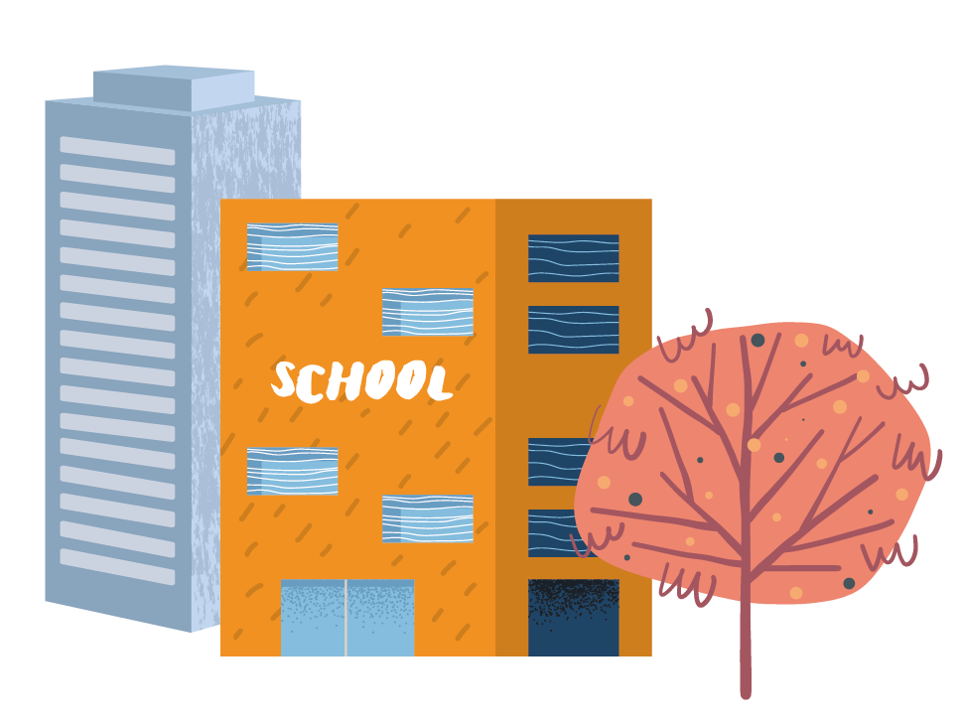



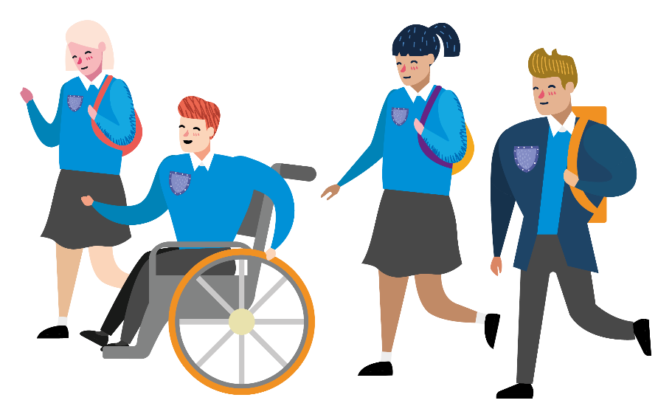
Travelling to your new school
Notes:
This presentation is designed to support your Next Steps to Secondary School KS3 Transition resources.
Use it to facilitate a short session on the summer transition day, either in the classroom or an assembly.
Alongside the resources in the classroom pack, it will help your pupils consider how they will get to/from their new secondary school and encourage the adoption of active travel.
Before you start, give each pupil a booklet from the classroom pack to work through during the session.

Slide 2
STARTING AT A NEW SCHOOL
IS REALLY EXCITING!
What do you think will be different?
Notes:
Kick off with some questions to engage your students in the sessions:
- Hands up if you’re excited about secondary school?
- Hands up if you think there are lots of things to do before you start?
- What things do you think will be different when you start secondary school?
Prompts: lessons, what you take with you, school dinners, people, teachers, place, size and TRAVEL
Moving up to secondary school is an exciting time, there are lots of things to think about and how you travel to and from your new school is one of them!

Slide 3


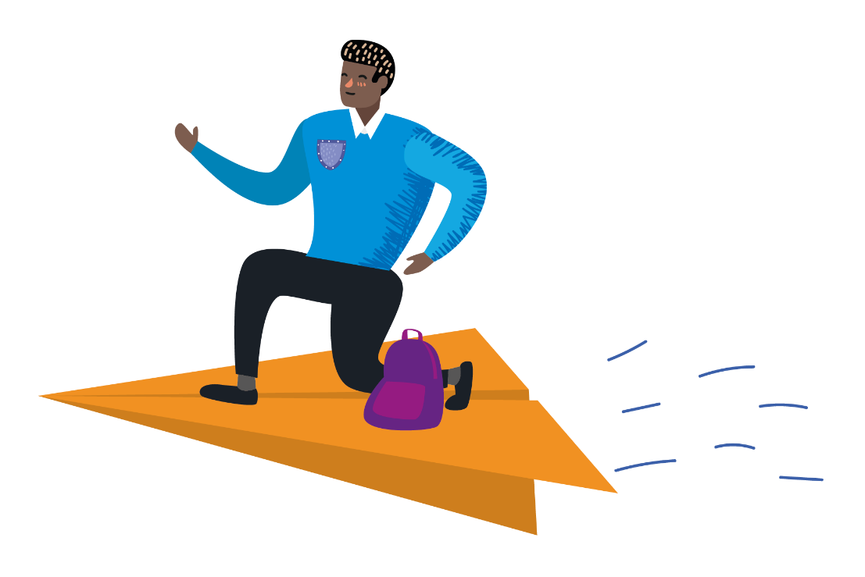
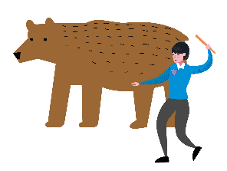


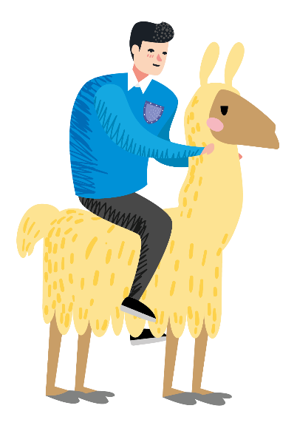


How could you travel to school?
Notes:
How you travel to secondary school might be different to how you travel to primary school.
Hands up if you have an idea of how you could travel to your new school?
Ask some students how they might travel to their new school.
Everybody’s journey is different and it’s important to find the best option for you.

Slide 4
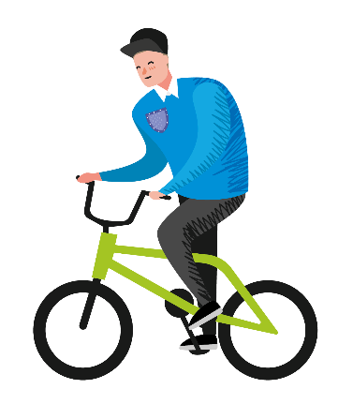
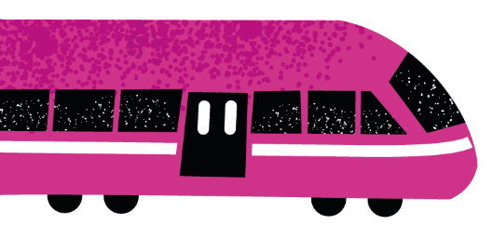
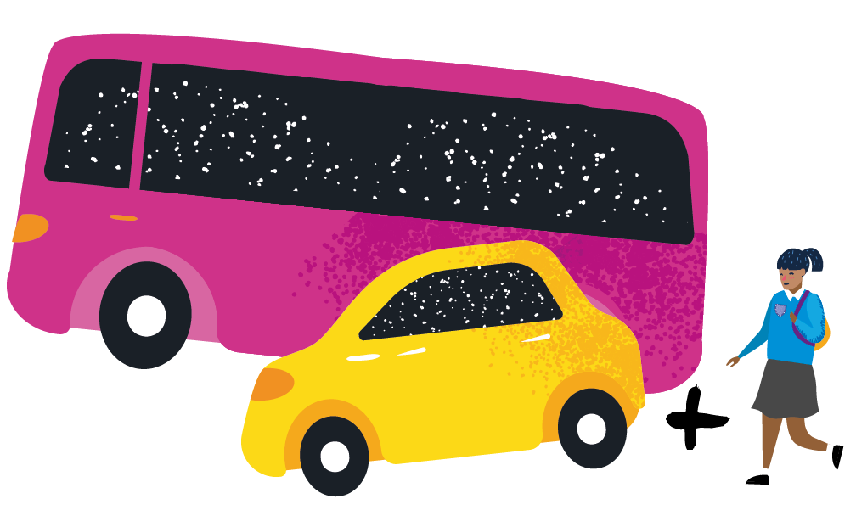
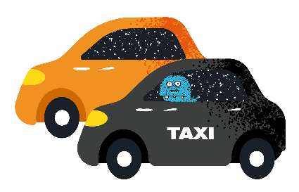
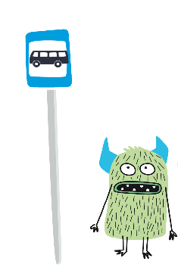

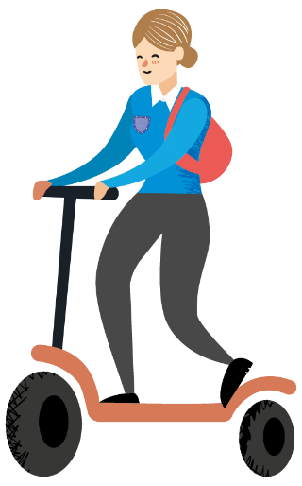
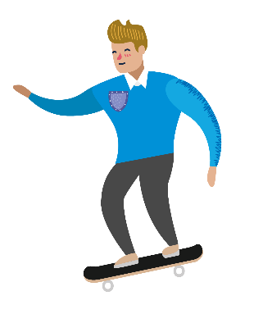
There are lots of ways to travel…
Notes:
There are lots of ways to travel, including:
Walk / wheel – walking or wheeling all the way to school
Includes those walking with mobility aids, such as wheelchairs or wheeled walkers.
Cycle / scoot / skate – riding to school on a bike, scooter or skateboard
Public transport – using buses and trains to get you to the school gate
Car / taxi – traveling directly to school by car
Walk part of the way – this combines public transport, car or taxi with a walk at the end to complete the journey. For example, getting out the car or off the bus a 10-minute walk from school, then walking / wheeling from there.

Slide 5


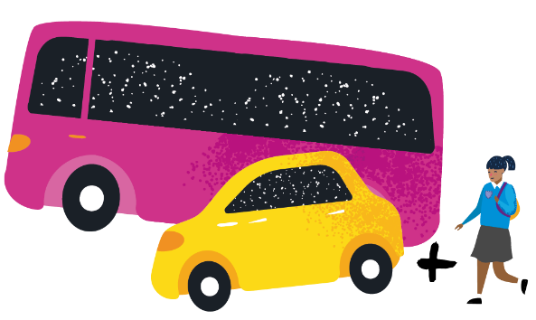


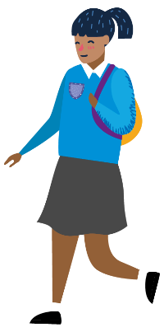



What’s good about each way of travelling?
Free and no equipment needed
PUBLIC TRANSPORT
5
Makes me feel good
WALK PART OF THE WAY
Time with my friends
Doesn’t cause pollution or climate change
WALK/WHEEL
Gives me more independence
Makes me feel wide awake
Helps me stay healthy
Weather won’t stop me
Doesn’t take too long
CAR OR TAXI
Easy for me
CYCLE/SCOOT/SKATE
Notes:
Ask your students to turn to the activity on pages 3 and 4 of their booklet.
The aim of this activity is to connect the ways of travelling with the benefits (10 green boxes) that apply to them.
Run through public transport example on slide:
- Ask pupils what they think might be benefits of catching the bus or train, then click to reveal answers
- Why are these benefits of catching the bus or train to school?
- Can anyone see another good reason to catch the bus or train?
Before they start the activity, remind the students this is about the journey between their home and new school. Their answers might be different to others for this reason.
You might have a chance to travel with friends and have more independence travelling without your parents. Some of you will get a free travel pass. If the bus stop or station is close to your house, it might be an easy option for you.
Everyone’s journey is different.
Give the students approximately 10 minutes to connect the benefits with the relevant modes of travel.

Slide 6




Which mode is
best for you?
PUBLIC TRANSPORT
5
Notes:
Once you have consider each mode of travel, score them by counting the number of benefits you have connected them to.

Slide 7
Which mode is
best for you?
PUBLIC TRANSPORT
How would you choose to travel?
5
Notes:
Finish the activity by completing the orange section:
Which mode of travel got the highest score?
Which mode of travel would you choose and why?

Slide 8
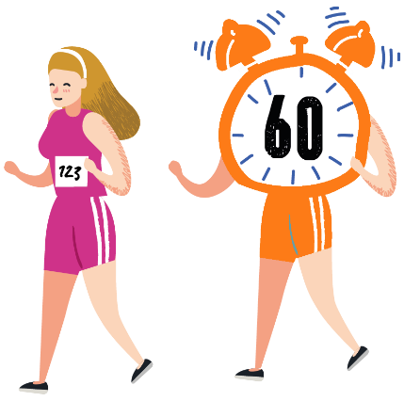



Reasons to move more
on your journey to school
Saves money
Helps you stay healthy
£££
Makes you feel happier
Doesn’t cause pollution
Time with friends
Gives you independence
Notes:
Some of you might need to use public transport or the car to travel to school but keeping active is really important. Here are some good reasons to include some physical activity, like walking, in your journey.
Ask the class whether they can think of some good reasons to be active on their journey, then click to reveal the answers on screen.

Slide 9

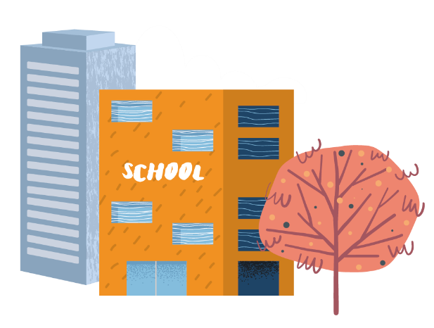
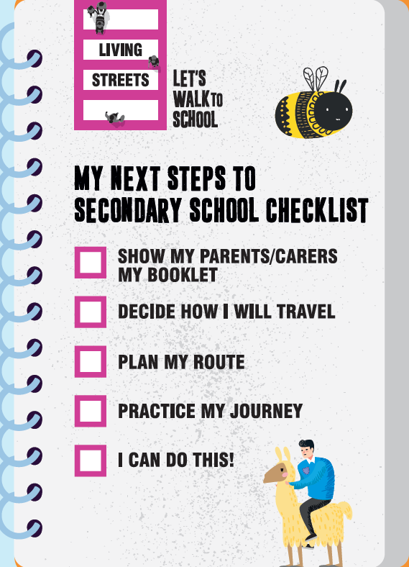

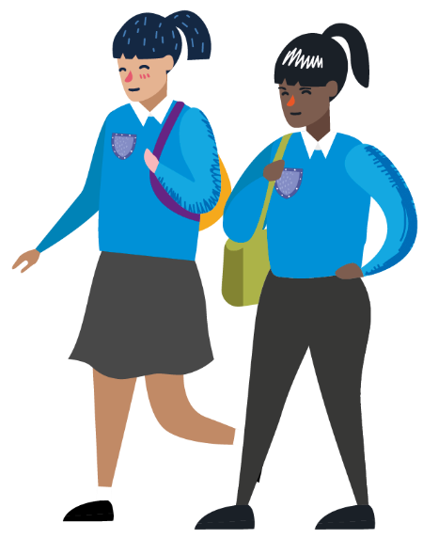

How will you travel to your new school?
Notes:
Finish the session by asking the students how they will travel to their new school and hand out a magnet to each one.
You might not be able to decide by yourself, you might need to find out more about your options and talk to your family and friends about it.
Put this magnetic checklist on your fridge and complete the tasks in order over the summer holiday:
Show my parents/carers this booklet - talk to your family about the benefits of the different ways of travelling to school.
Decide how I will travel - which option is best for you?
Plan my route - which way you will walk or cycle, where will you catch the bus?
Practice my journey - you could do this with family or with friends who you will be travelling to school with.
I can do this! - once you’ve done this, you’re ready to go.

Slide 10


